Slide 1
GICTV Presentation
Brian Fitzgerald Australian PGA Member 35 years
Totally self taught in all things technology
www.thegolfdoctor.com.au

Slide 2
Why YouTube
2nd biggest search engine
Free to set up
Potential to earn income
Worldwide audience
www.thegolfdoctor.com.au

Slide 3
YouTube Monetization Requirements In 2020
4,000 hours of watch time over a 12 month period
1000 subscribers
Back when I started this was not the case. Anyone could apply to be a YouTube Partner
www.thegolfdoctor.com.au

Slide 4
My YouTube Journey
June 14 2014
www.thegolfdoctor.com.au

Slide 5
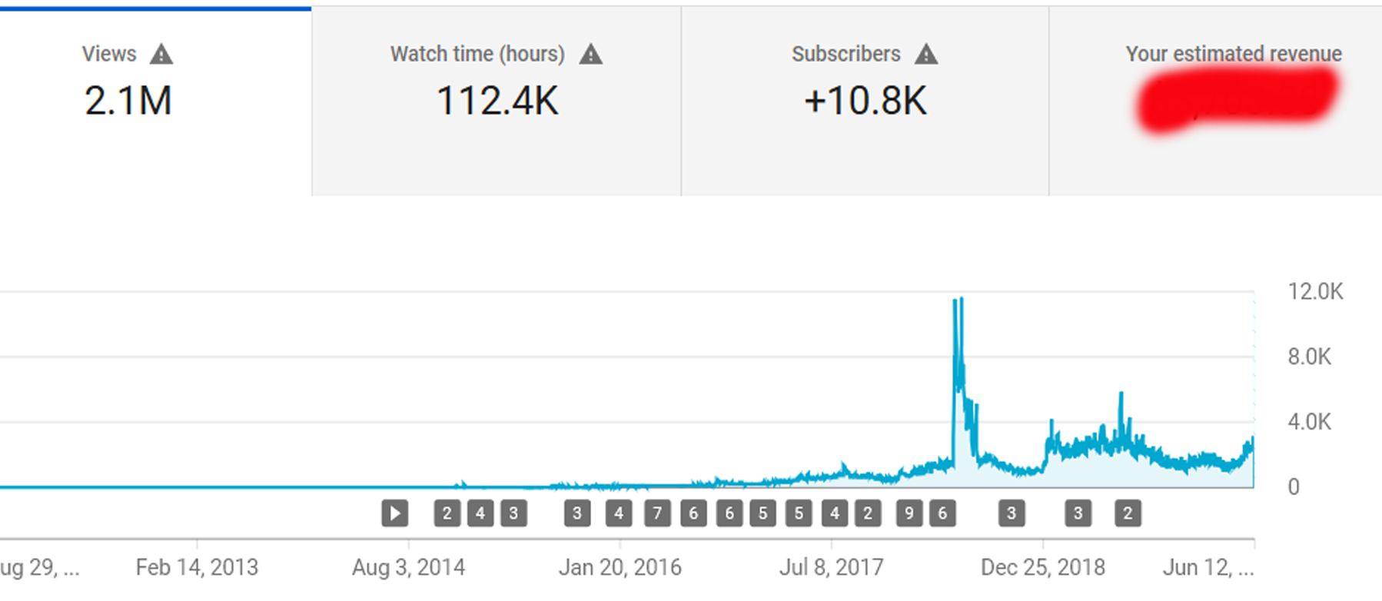
My YouTube Journey
I wanted to get more clients for my coaching business at the Morack Public Golf Course
I began uploading videos on June 14 2014
Currently I have over 2.1 million views & 10,800 subscribers
www.thegolfdoctor.com.au

Slide 6
My YouTube Journey
YouTube pays you once you have accumulated US $100
I got my first payment after 22 months and 109 videos
$ 103.79
My 2nd payment took 12 months and 53 videos
$ 120.75
My 3rd payment took 2 months and 8 videos
$ 104.18
I have been getting monthly payments since 22nd February 2018
Based on these numbers most creators give up. I was making money through this period but not from YouTube
www.thegolfdoctor.com.au

Slide 7
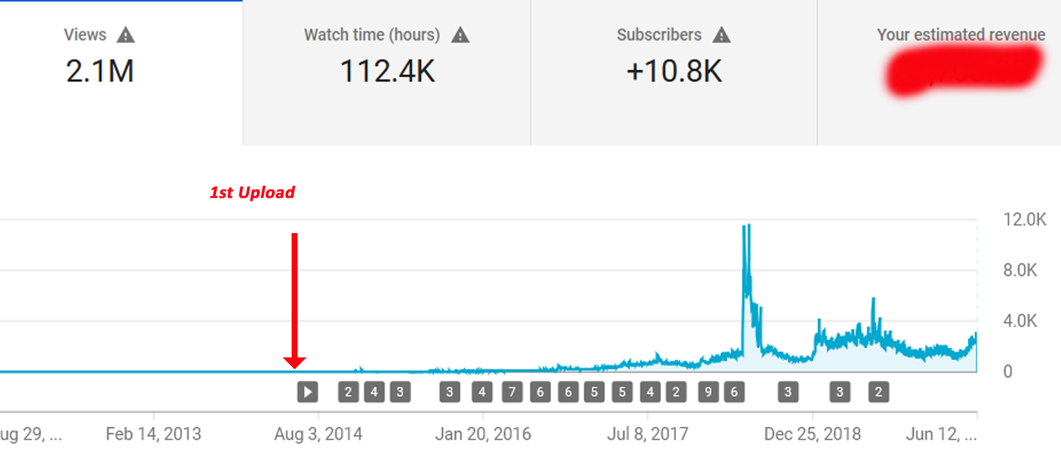
My YouTube Journey
www.thegolfdoctor.com.au

Slide 8
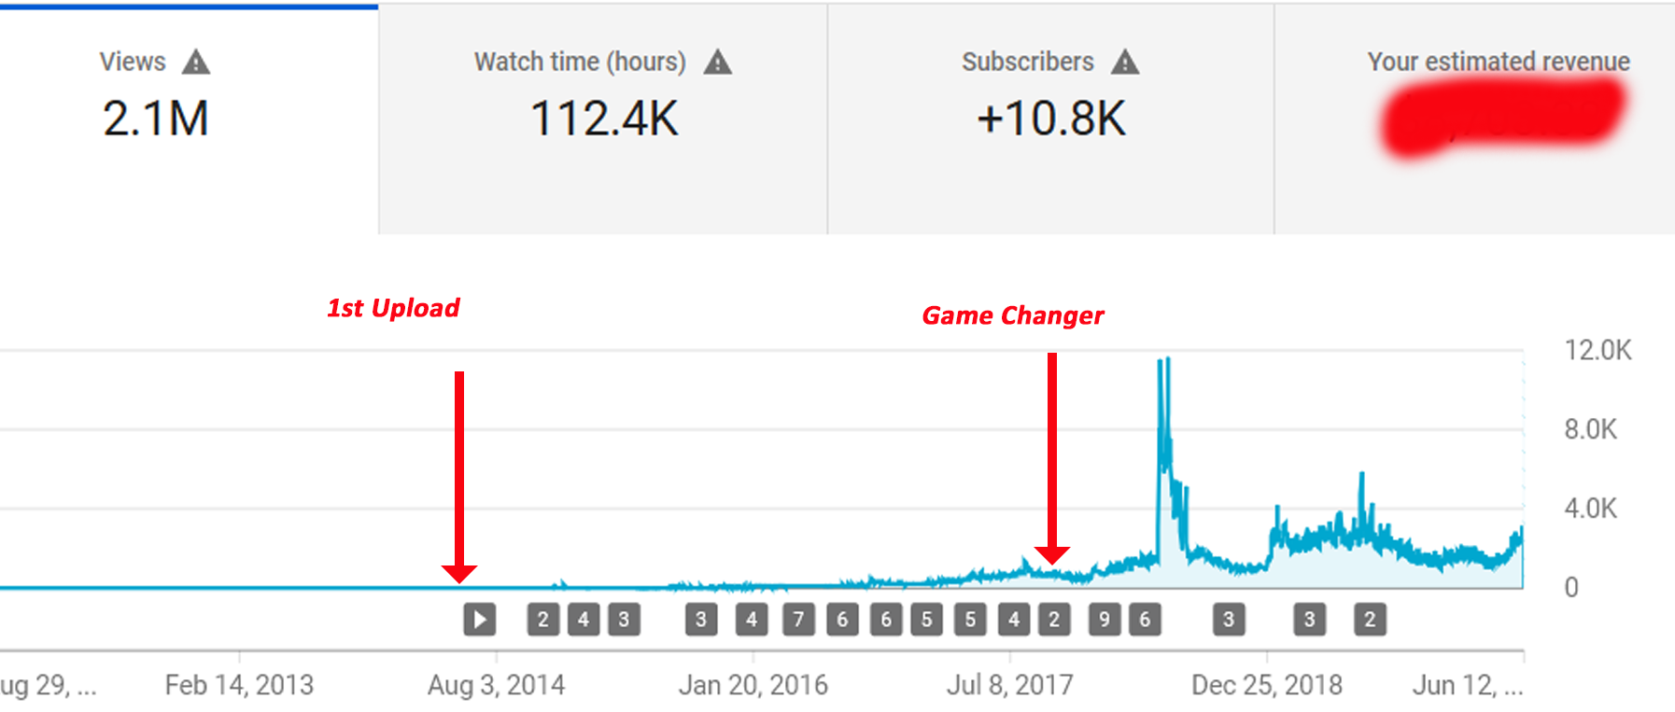
My YouTube Journey
December 25th 2017
www.thegolfdoctor.com.au

Slide 9
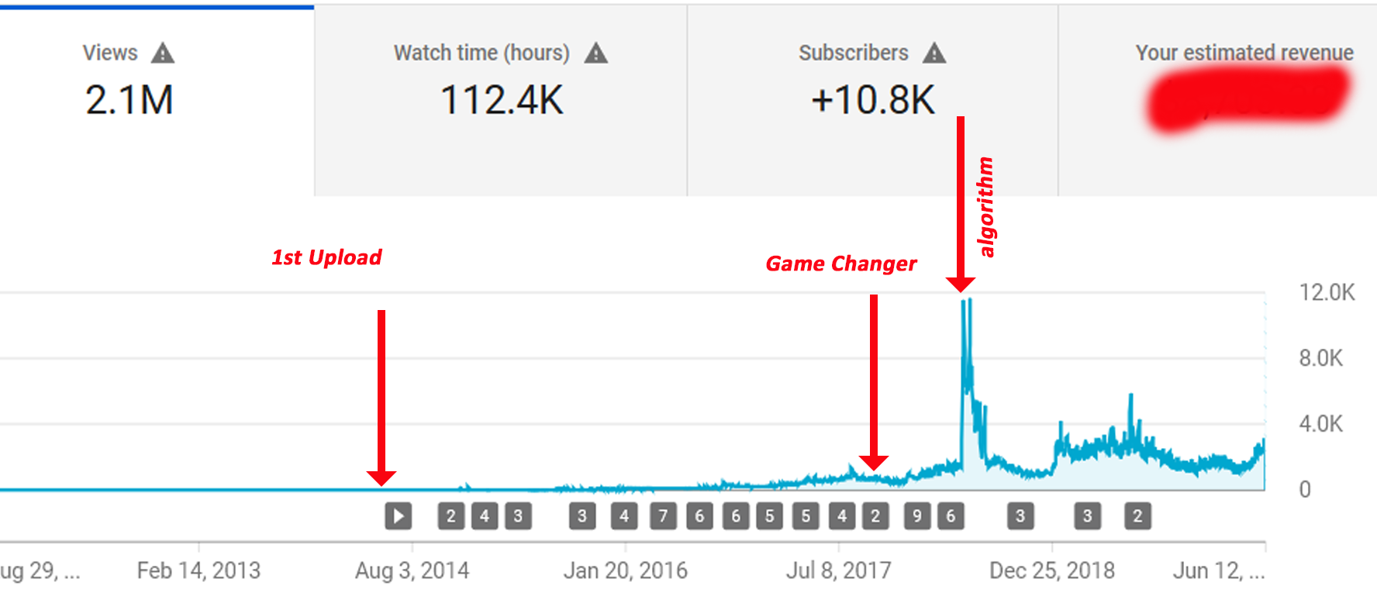
My YouTube Journey
May 1st 2018
www.thegolfdoctor.com.au

Slide 10
My YouTube Journey
www.thegolfdoctor.com.au

Slide 11
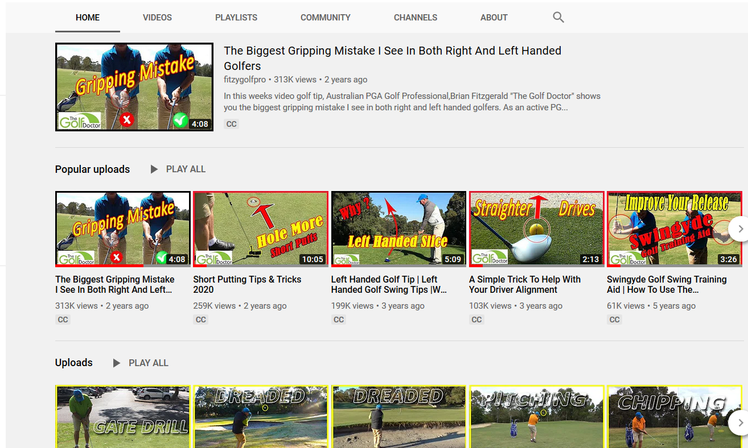
My YouTube Journey
www.thegolfdoctor.com.au

Slide 12
My YouTube Journey
YouTube is hard why bother?
Only 3% of creators make it to 10,000 subscribers
80% of my views come from outside Australia
Within 12 months of me uploading my first video I was being contacted by overseas golfers wanting to spend time with me while here on business or holiday.
I noticed people referring to my videos straight away.
YouTube is now responsible for 30% of my coaching income
I coach golfers from all over the world via my Membership platform
www.thegolfdoctor.com.au

Slide 13
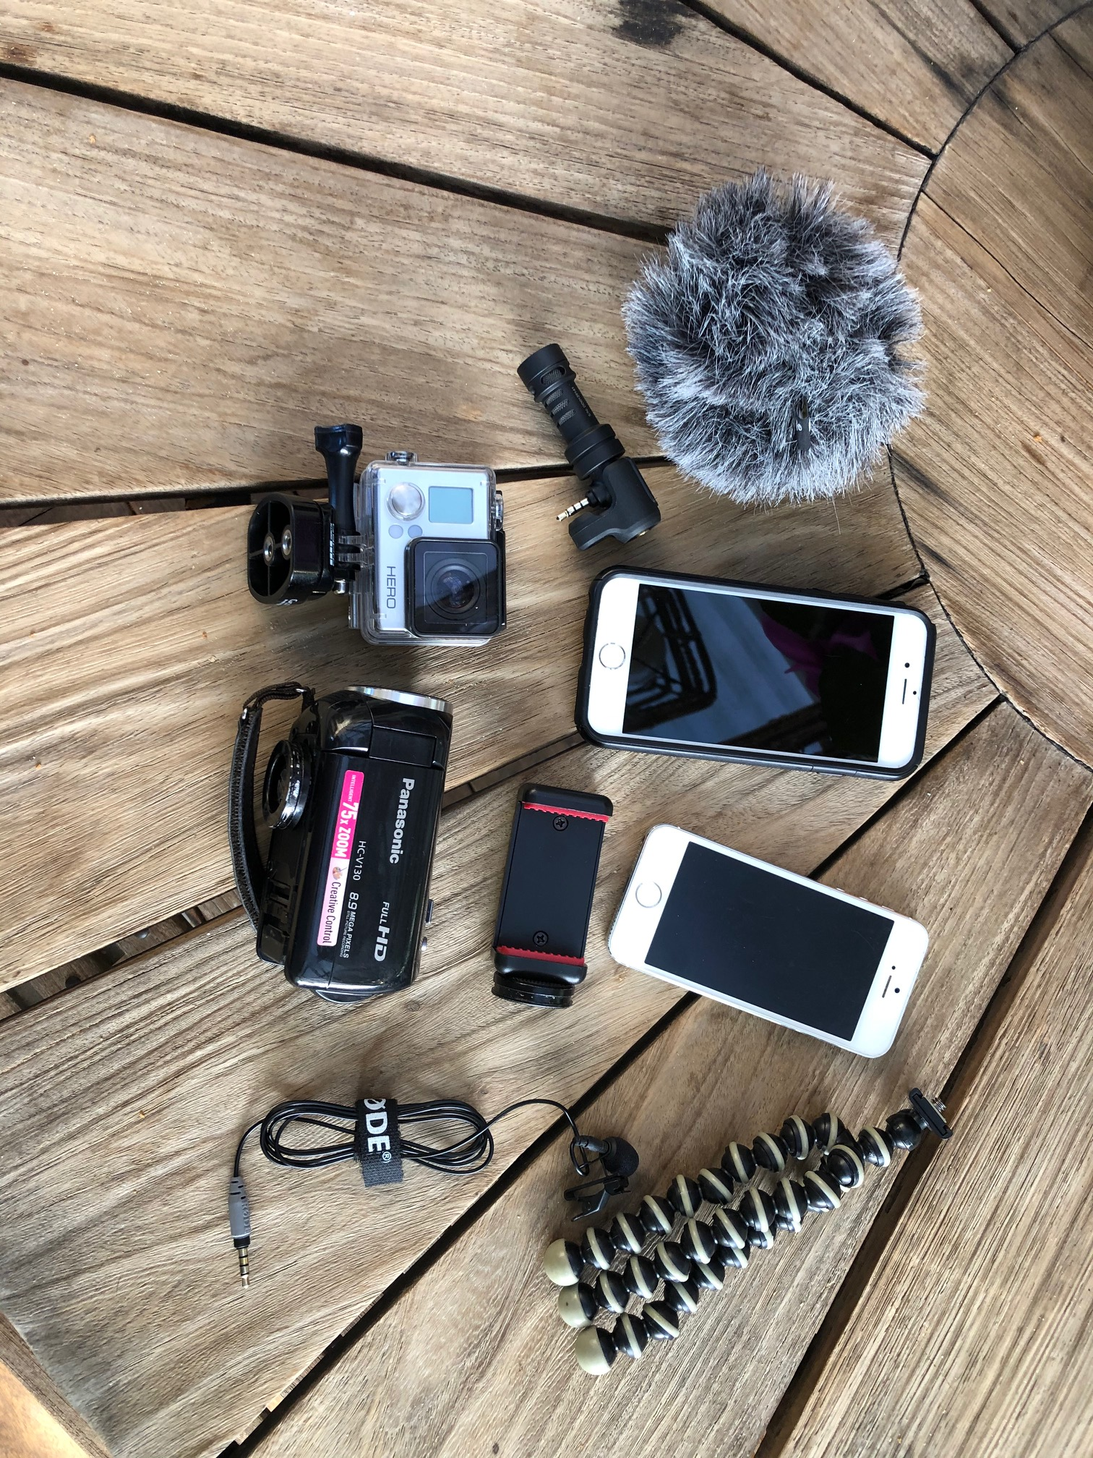
My Equipment
www.thegolfdoctor.com.au

Slide 14
My Software
I started using Pinnacle Studio
I have been using Adobe Premiere Pro for the past 10 months
I have used imovie Premiere Rush and Videorama for mobile editing of movies.
RODE Record for recording my audio on my phone
Trello for my organization of video production
www.thegolfdoctor.com.au

Slide 15
My YouTube Journey
Things that will help you on your YouTube Journey
Research your topic
Make videos for humans – ie. that people want to watch
Plan out the title, thumbnail and description before you press record
Use your mobile phone & invest in a good microphone. Sound can make or break your video
Find a schedule and stick to it
Be patient
Make lots of mistakes that’s how you learn
Keep improving your skills. Make each video better than the last
www.thegolfdoctor.com.au

Slide 16
My YouTube Journey
Get to know what’s under the hood. YouTube Analytics
The 3 Most Important Things To Concentrate On
The SEO of the video - title, tags and description
Creating a great thumbnail and pay attention to it’s CTR
Analyze the engagement of the video
www.thegolfdoctor.com.au

Slide 17
Questions?
brian@thegolfdoctor.com.au
www.thegolfdoctor.com.au

