Slide 1
Golf content on websites,
blogs and social media
Michael Green
AussieGolfer.com.au - Teepster.com

Slide 2
Back to the beginning
Launched AussieGolfer in 2006
What was a blog?
Twitter started, Facebook was a couple of years old
Notes:
I started Aussie Golfer very much a stock standard blog in 2006. Twitter had just been launched and Facebook was just a couple of years old. I recall checking out Twitter… And I had no idea Facebook would be a source of news...

Slide 3
Back in the ol’ days
Selfish start - what I wanted to say, what I wanted to know?
How and when can I watch the golf?

Slide 4
Back in the ol’ days
Selfish start - what I wanted to say, what I wanted to know?
How and when can I watch the golf?
Has anyone else tried these new shoes?

Slide 5
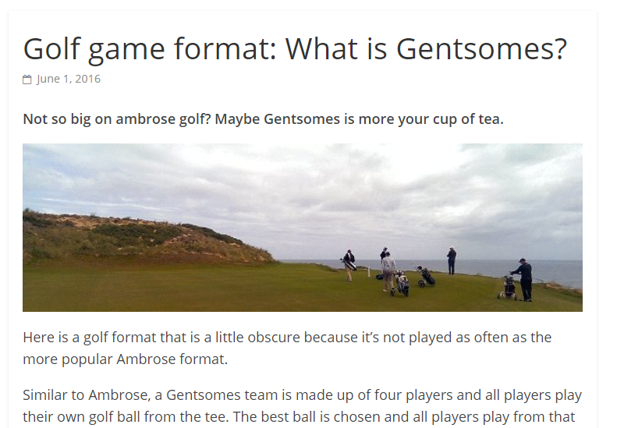
Missing content?
Selfish start - what I wanted to say, what I wanted to know?
How and when can I watch the golf?
Has anyone else tried these new shoes?
How do you play that golf format?
What is the ruling on this?

Slide 6
Missing content?
Selfish start - what I wanted to say, what I wanted to know?
How and when can I watch the golf?
Has anyone else tried these new shoes?
How do you play that golf format?
What is the ruling on this?
Handicaps

Slide 7
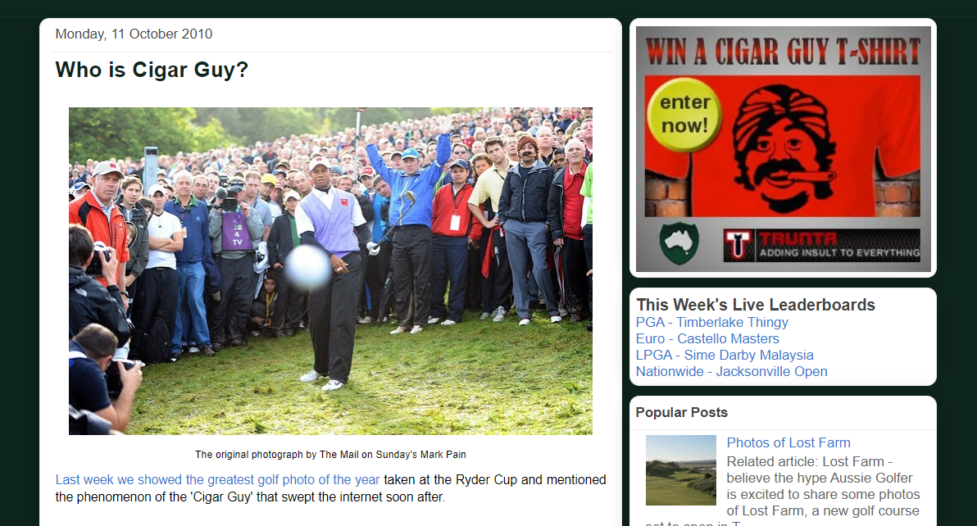
‘Golf is just a game’ content
Golf is not necessarily this serious, exclusive sport
Golfers, and non-golfers were craving the silly golf content.

Slide 8
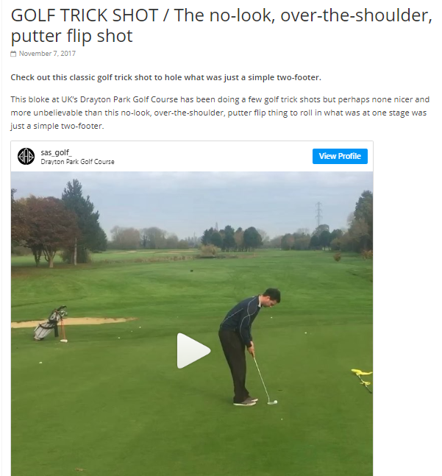
‘Golf is just a game’ content
Golf is not necessarily this serious, exclusive sport
Golfers, and non-golfers were craving the silly golf content.
Relatable content!

Slide 9
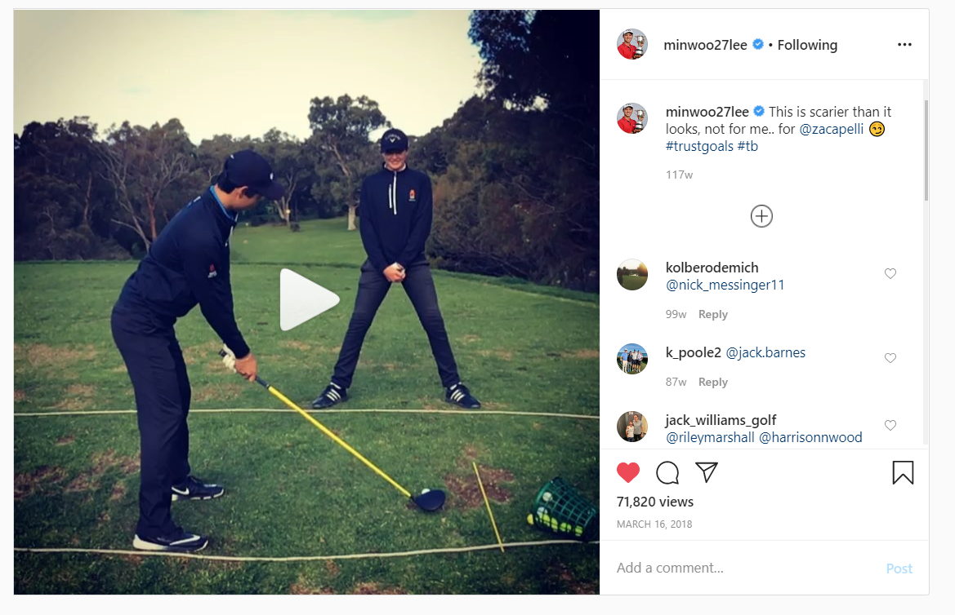
‘Golf is just a game’ content
Golf is not necessarily this serious, exclusive sport
Golfers, and non-golfers were craving the silly golf content.
Relatable content!
Trick shots,

Slide 10
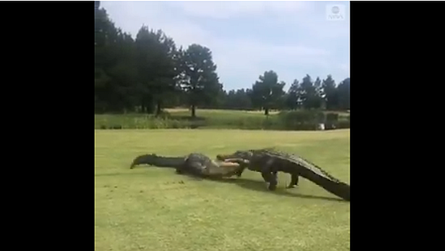
‘Golf is just a game’ content
Golf is not necessarily this serious, exclusive sport
Golfers, and non-golfers were craving the silly golf content.
Relatable content!
Trick shots, dummy spits, animals,

Slide 11
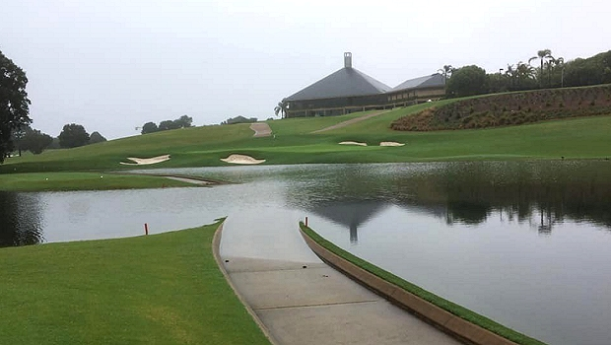
‘Golf is just a game’ content
Golf is not necessarily this serious, exclusive sport
Golfers, and non-golfers were craving the silly golf content.
Relatable content!
Trick shots, dummy spits, animals, golf memes, crazy weather.

Slide 12
What is better now?
Notes:
Some of this contect was already available in golf magazines and some of it was freely available in golf industry circles. But

Slide 13
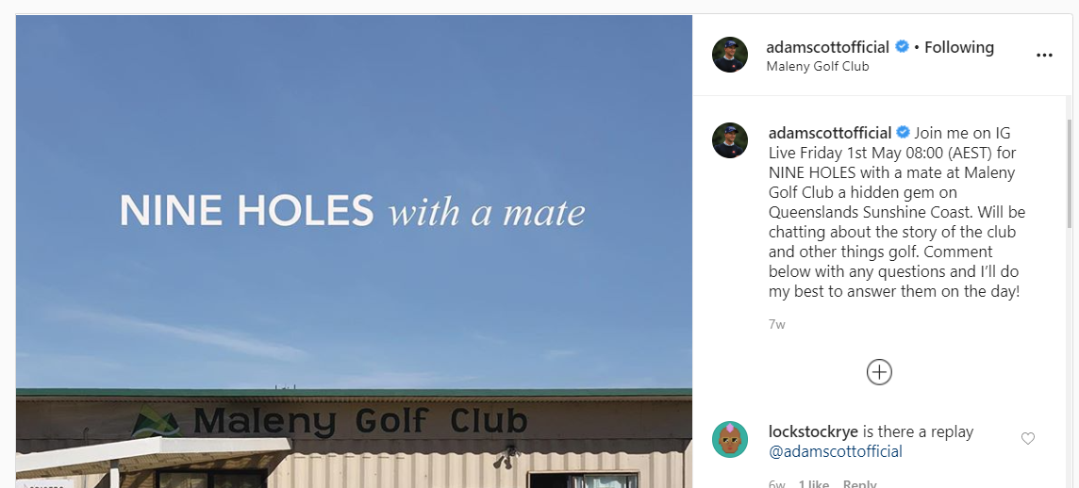
What works
Big names, pro golfers
Well-known golf manufacturers
Pro tours
Best golf courses

Slide 14
What works
Big names, pro golfers
Well-known golf manufacturers
Pro tours
Best golf courses

Slide 15
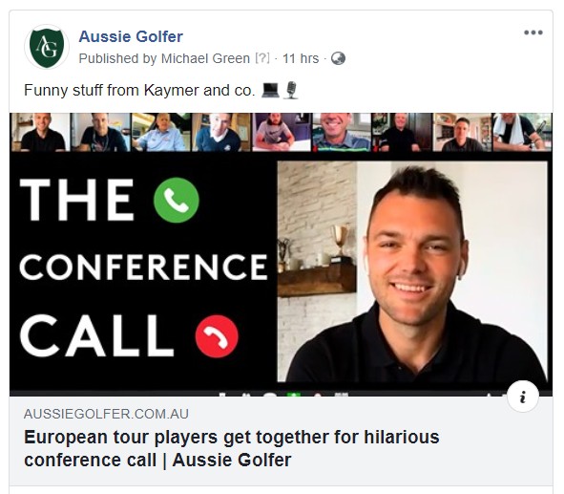
What works
Big names, pro golfers
Well-known golf manufacturers
Pro tours
Best golf courses

Slide 16
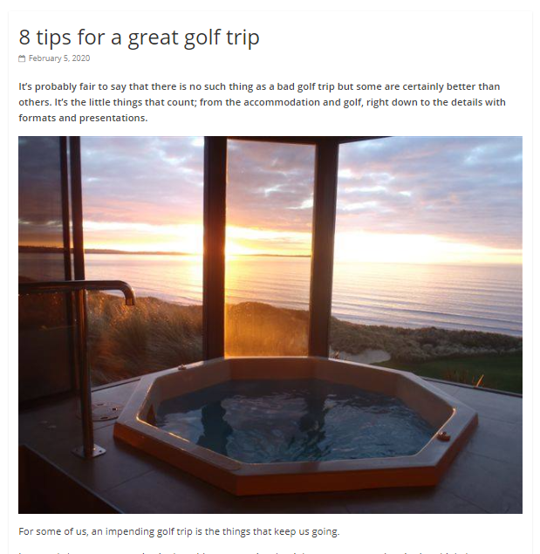
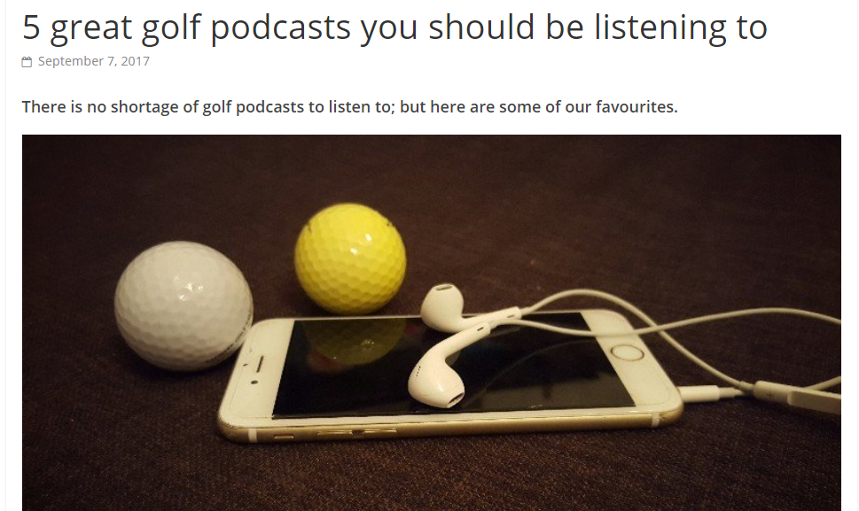
What works
Lists

Slide 17
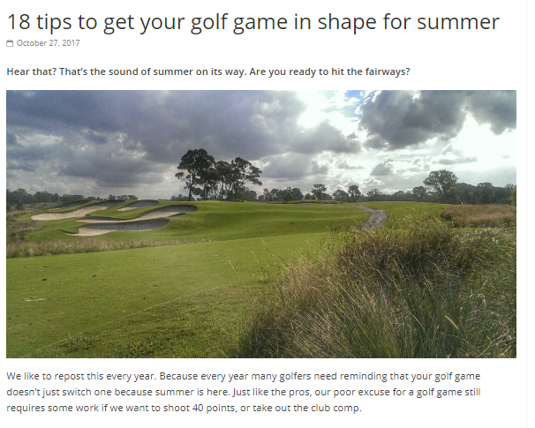
What works
Lists
“Your golf game”

Slide 18
What works
Lists
“Your golf game”
How to go about playing golf

Slide 19
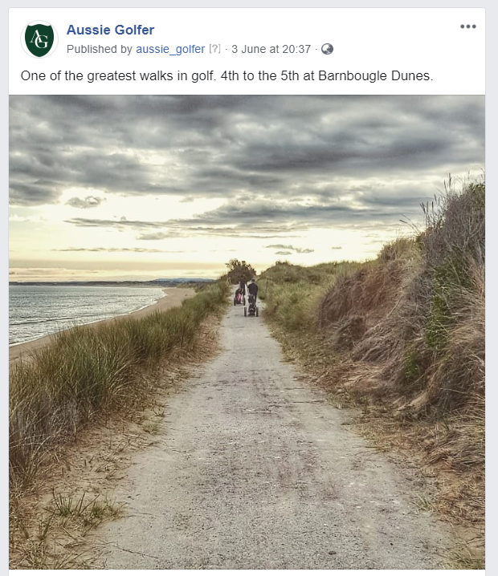
What works
Lists
“Your golf game”
How to go about playing golf
Great photos, Instagram

Slide 20
What works
Lists
“Your golf game”
How to go about playing golf
Great photos, Instagram
Great golf courses, sneak peaks

Slide 21
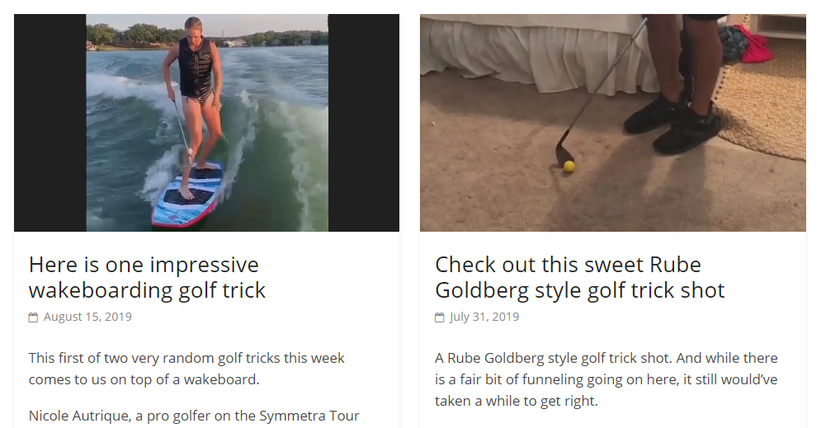
What works
Lists
“Your golf game”
How to go about playing golf
Great photos, Instagram
Great golf courses, sneak peaks
Silly stuff

Slide 22
More recently
Lists
“Your golf game”
How to go about playing golf
Great photos, Instagram
Great golf courses, sneak peaks
Silly stuff
Extraordinary club news!

Slide 23
Content variety

