Slide 1
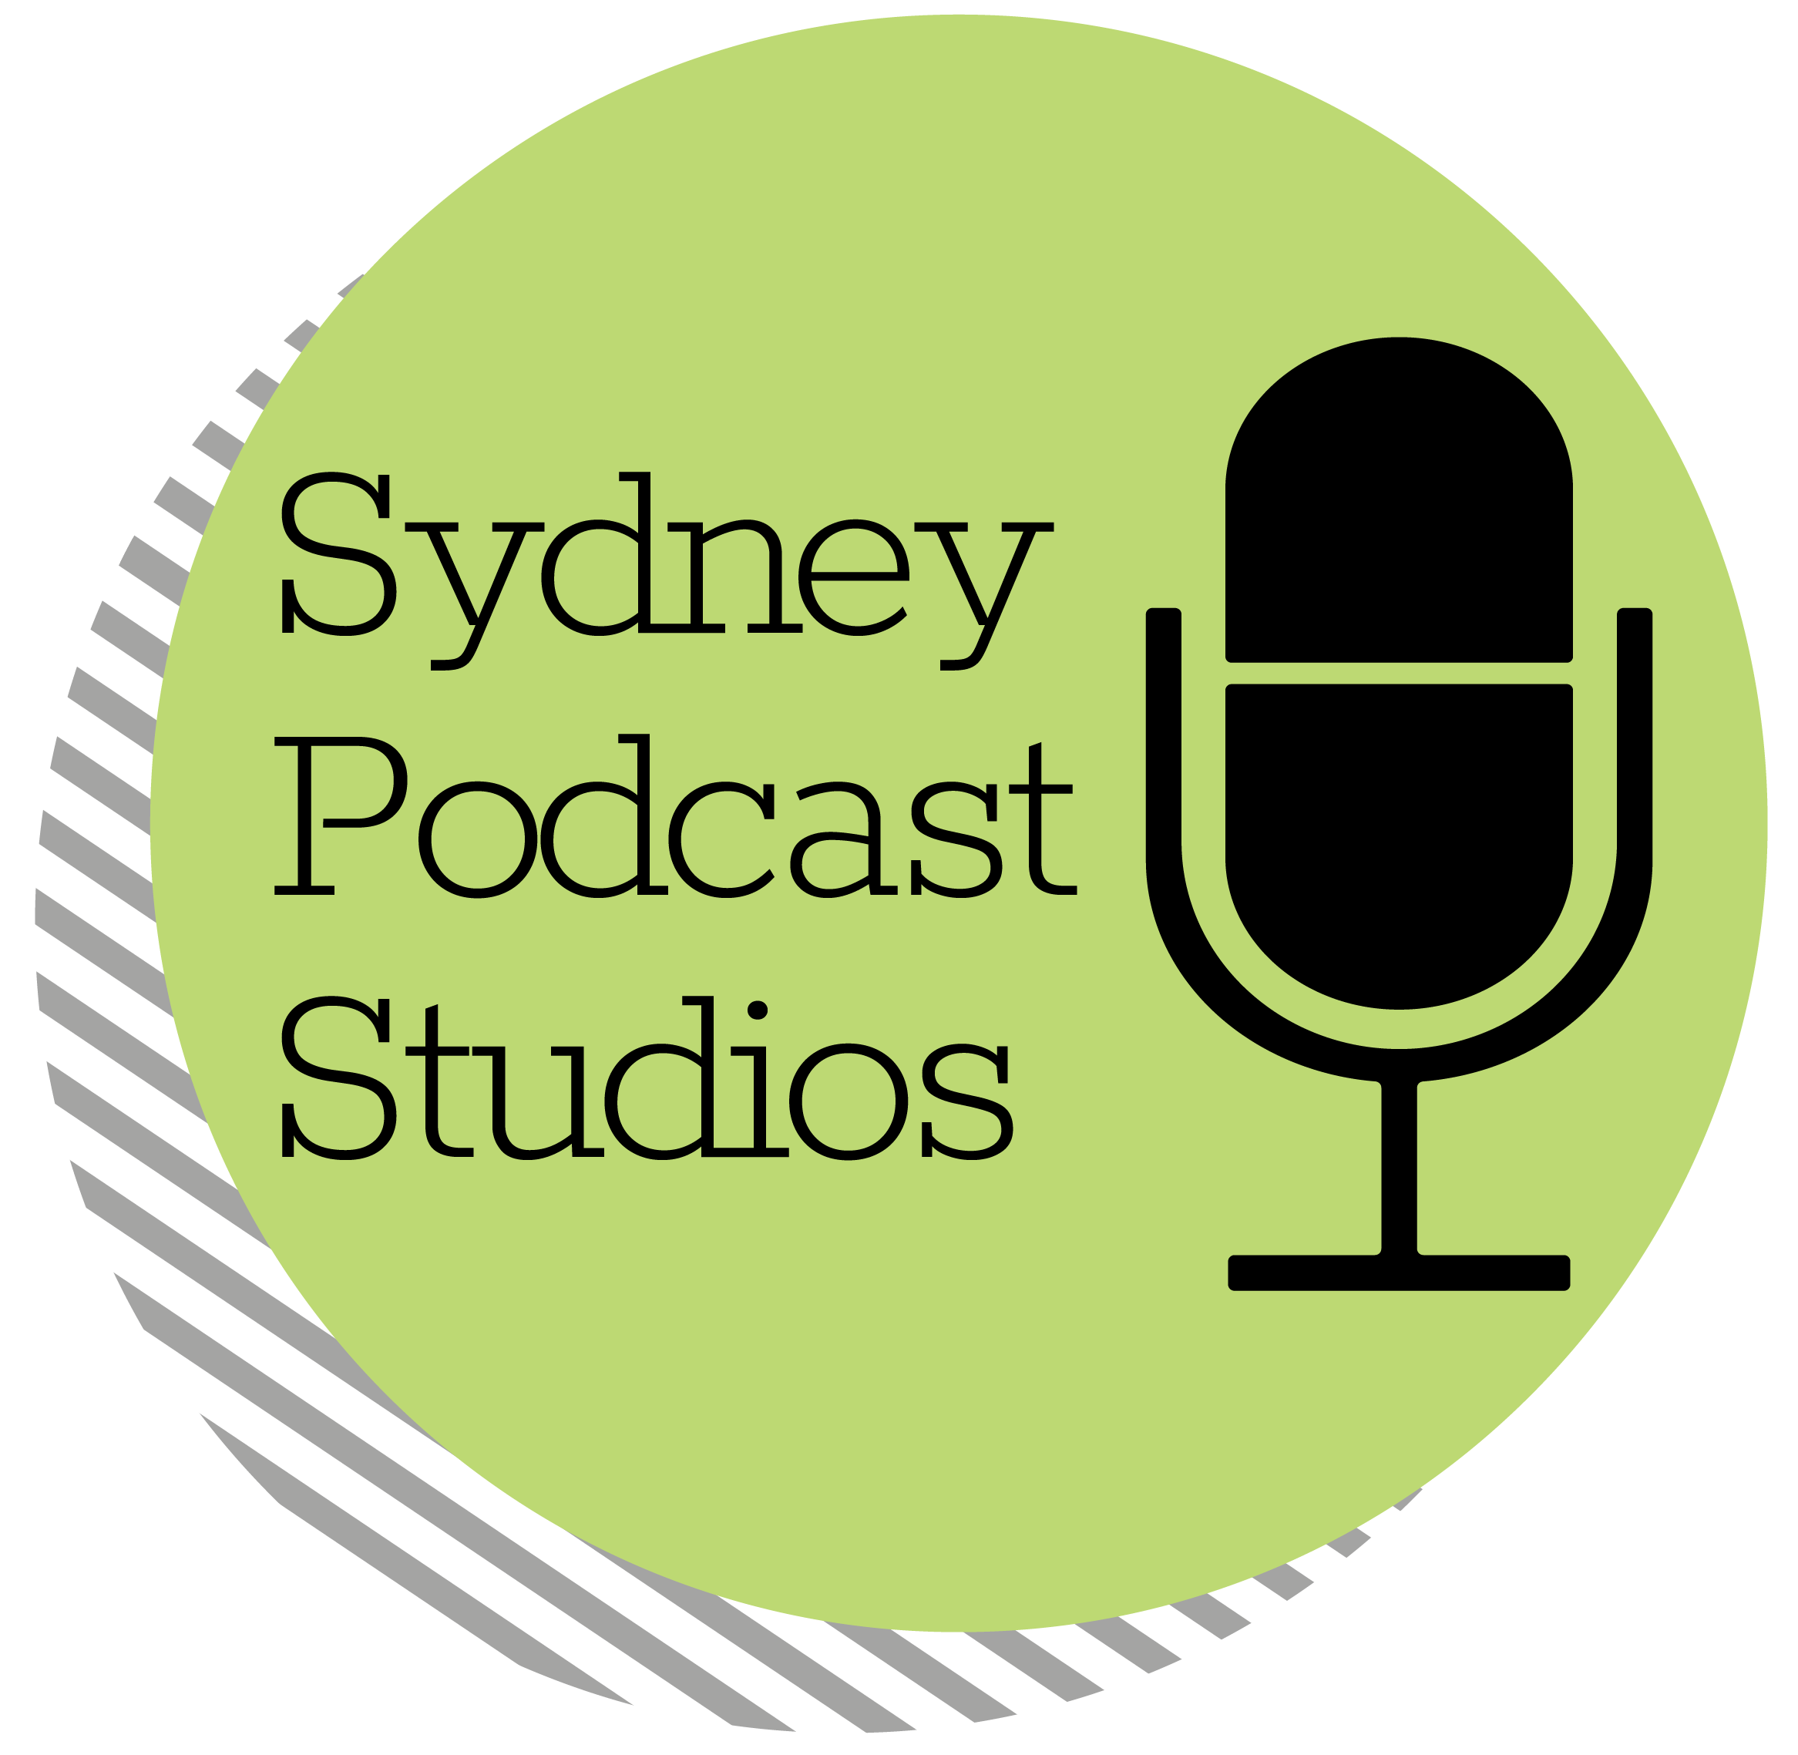
Podcasting
the new black?

Slide 2
Who’s Listening?
GENDER
54%
45%
89%
AGE
of Australians are aware of podcasts.

Slide 3
What a Podcast isn’t
How do people see podcasts and what are they really?
Podcasting
IS NOT
Radio
Podcasting
IS
Another Type of Social Media

Slide 4
Why Podcast?
Your audience has a vested interest in the content.
You control the message.

Slide 5
How to get started?
DIY Podcasting is eminently achievable and can be done for a few hundred dollars
Creating a podcast is no more difficult than editing a Word document – once you know how
$

Slide 6
Where can you get help?
Sydney Podcast Studios runs a ‘Podcast School’ to learn the basics
If DIY doesn’t appeal consider having your podcast professionally
produced (it’s cheaper than you think)

